Slide 1

TRAFFIC SIGN CLASSIFICATION
April Meyer
DSC680-T301 Applied Data Science (2215-1)

Slide 2
Introduction and problem statement
With the major advancements in self driving cars and smart cars has given way to a new classification problem for identifying traffic signs. The self-driving cars require the ability to know the current speed limit, stop signs, etc. Also, some car manufacturers can use a classification system to identify the traffic sign and notify the driver.
Convolutional neural networks or ConnvNets are a great way to classify images and thus can be used to classify traffic signs (3).
This project seeks to show how to build a convolutional neural network (CNN) identify traffic signs.

Slide 3
Data Source
Convolutional Neural Networks (CNN)
Preprocessed data containing German Traffic Signs saved into pickle files
https://www.kaggle.com/valentynsichkar/traffic-signs-preprocessed

Slide 4
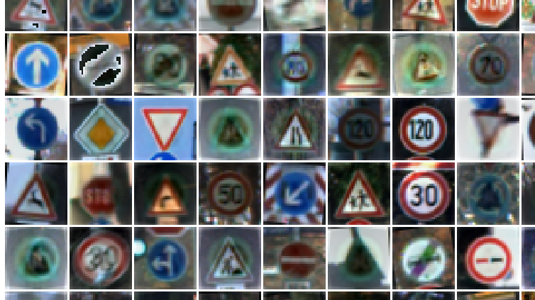
Data exploration
The dataset has 43 types of signs, classes. Training subset contains 86989 images, validation subset contains 4410 images and testing subset contains 12630 images. The images are 3-channeled RGB with a size resolution of 32 X 32 pixels.
y_test: (12630,)
y_validation: (4410, 43)
x_validation: (4410, 32, 32, 3)
x_train: (86989, 32, 32, 3)
y_train: (86989, 43)
labels: 43
x_test: (12630, 32, 32, 3)

Slide 5
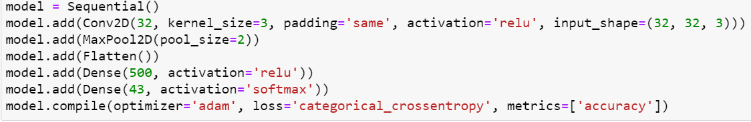
Model - Convolutional Neural Networks (CNN)
The preprocessed dataset is loaded from the pickle file
The RGB image is fed into the ConvNet layer that contains 32 filters.
Rectified Linear Unit (relu) activation function that excludes negatives with zeros (3).
A pooling layer is applied that reduces the layer (3) then a hidden fully connected layer that is 500 neurons.
The output layer has 43 neurons which aligns with the number of classes.

Slide 6
Model - Convolutional Neural Networks (CNN)
The compilation step has the optimizer, loss function, and the metric used to observe (3).
Adam is used as the optimizer. Instead of being a gradient descent it is an adaptive optimizer.
Categorical Crossentropy was used since it is for multi-class classification tasks. This is where only one image can belong to one out of several possible categories, and the model determines which one (3).

Slide 7
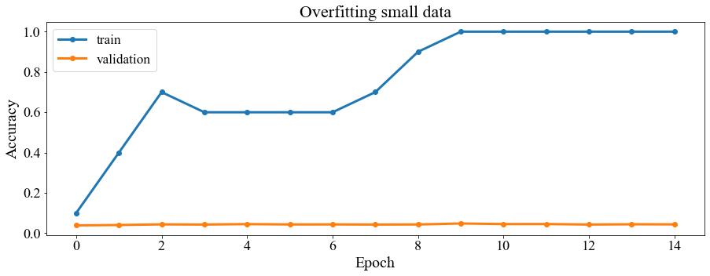
Results - overfitting
It was overfitted by only training on 10 samples and validating on 4410.
Epochs=15, training accuracy=1.00000, validation accuracy=0.04830

Slide 8
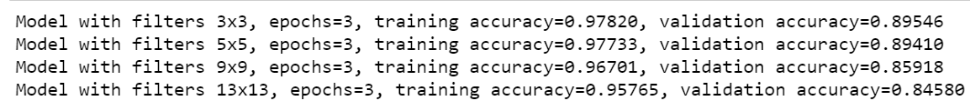
Results - using the whole training set (86989)

Slide 9
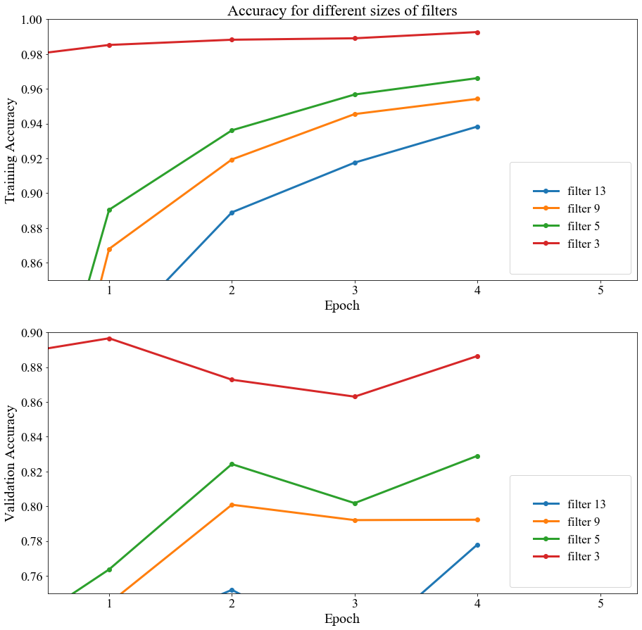

Slide 10
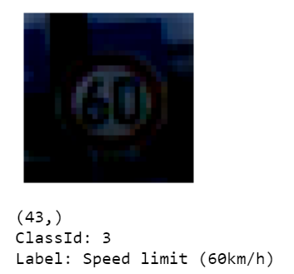
Prediction of image from test data

Slide 11

Conclusion
Dataset was preprocessed German traffic signs
Convolutional Neural Network
The classification accuracy equal to 89.6%, 82.9%, 80.1% and 77.8 %

Slide 12

Thank You
I would like to acknowledge the Kaggle Repository for providing this dataset I used for the project.

